Slide 1
Used Car Price Prediction.

Slide 2
Problem Statement.
With the covid 19 impact in the market, we have seen lot of changes in the car market. Now some cars are in demand hence making them costly and some are not in demand hence cheaper. This project needs to be done in two phases -
  Data collection Phase – We have to scrape atleast 5000 used cars data. Data can be collected from websites like (cardekho, Olx, Cars24 etc.) We need to do this using web scraping. Data needs to be fetched from different locations. The number of columns for dataset does not have a limit therefore, we can select as many attribute as necessary. It is asked to include all types of cars in the dataset for example- SUV, Sedans, Coupe, minivan, Hatchback.
  Model Buiding Phase – After collecting the data we need to build a machine learning model. Before model buiding data pre-processing needs to be done. Different models with different hyper parameters should be trie and then select the best model.

Slide 3
Data Collection Phase
The data collected during this phase is obtained from cardekho website using Selenium library in python. This phase of the project can be explained as a chain of events and are described in the steps below.
  Using python selenium to open chromium web driver.
  Then the cardekho website homepage is visited using this chromium browser.
  On the homepage the used car navigation button is clicked and we are redirected to a new page containing a list of metropolitan locations in India.
  The web element for these locations are captured and the url for these locations results are saved.
  After visiting one of these location urls. We get a list of used cars in that location.
  The page url for all the used cars on this location is stored in the used cars url list.
  This is repeated for all the locations in the list.
  On visiting one of these used cars url it is seen that there are many specifications and features of a car. The most relevant of them are Brand, Model, Manufacturing Year, Driven Kilometers, Fuel Type, Number of Previous Owners, Mileage, Engine Volume, Power and Torque. Also the page also shows the target feature of this project that is the price of a car.
  These specification and features are taken for all the used cars web pages.

Slide 4
Data Cleaning
The data obtained from cardekho website has a lot of physically impossible data. It also has various features with numerical string values that needs to be converted. Some features also contain different unit of measures which needs to be standardised.
Column Brand_Model consists of data for two features Brand and Model. This column is split into two features using feature engineering.
Column Manufacturing Yr does not need any cleaning.
Column Engine consists of data about a used car’s engine volume. The volume of an engine is measured using “cc”. Therefore all entries in this columns ending with cc is accepted and clearning all other entries are dropped.
Column Transmission can only have two values Manual and Automatic but as it is seen some elements have physically impossible data these entries are removed from the dataset.
In column Driven_kms the elements have values ending with kms or Kms these values are accepted and all other values are dropped from the dataset.
Column No. Owners has categorical values where values like “1st Owner” and “First Owner” have the same meaning.

Slide 5
Data Cleaning(Contd.)
In column Mileage we have values of different units of measure. These values needs to be standardised to find the actual correlation of this feature. Therefore, the mileage is converted to the cost of driving one kilometer. All physically impossible values are dropped.
In column Power, the unit of measurement used is BHP. Therefore, values with unit of measurement as bhp is taken and all other values are removed.
In column torque, torque can be measured either in kgm or Nm. This needs to be standardised in this Nm is kept as the standard unit of measurement.
Finally, in Price column entries ending with “Lakh” and “Cr” needs to be transformed into numerical values therefore we’ll multiply the numerical part of an entry with either 10^5 or 10^7 respectively.

Slide 6
Encoding
There are a few categorical features in this dataset they need to be converted to numerical values. This is done using sklearn.preprocessing library’s Label Encoder. This encoding is applied on the following columns:- Transmission, Fuel Type, No. Owners, Brand, Model, Location. Encoding will create classes based on the number of unique values inside a feature.

Slide 7
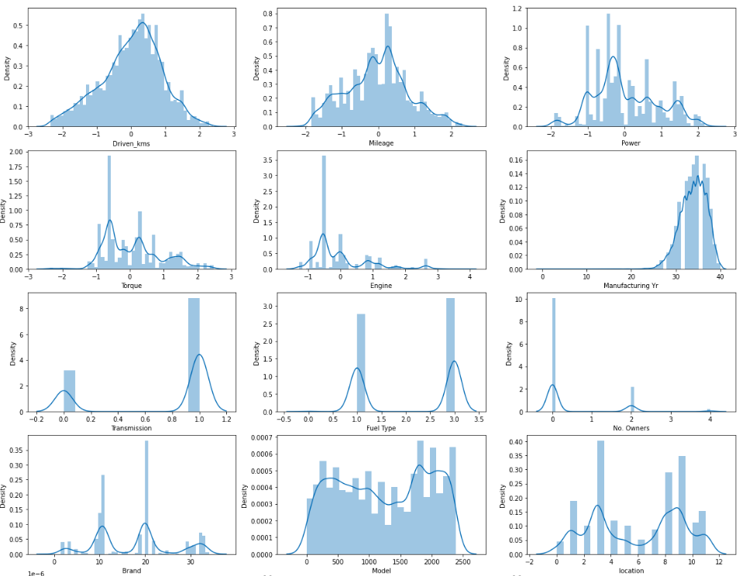
EDA
Distribution Graph
From the following graphs it can be seen that columns Driven_kms, Mileage and Power have normal distribution.
However, columns Torque and Engine have some skewness in them.
This skewness can cause reduction in the model’s ability to learn from the dataset.
To solve this problem these features need to be normalised.
This normalisation can be done by scaling the features or transforming them.
We have applied Power Transformer to normalise the distribution.

Slide 8
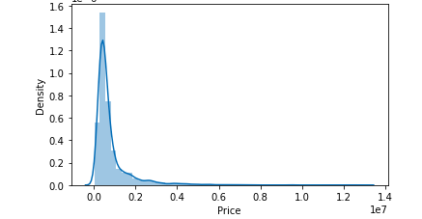
EDA
Distribution Graph
As it can be seen from the the following graph. The target feature Price has highly right skewed distribution. This will reduce models’ learning accuracy. It can be seen that the values in feature Price ranges from 35,000 to 1,90,00,000. Therefore, I’ve used Log Transform to normalize the distribution and get a feature which will help the model to learn better.

Slide 9
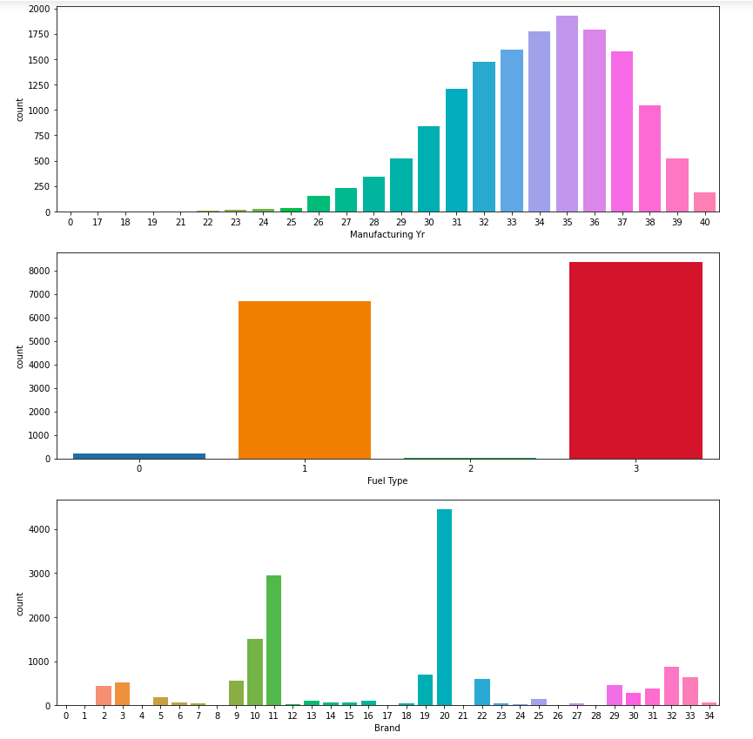
EDA
Count Plot for Categorical Distribution.
In the following columns we can see that the classes in these features have different distributions. So we can say that the class distributions is imbalanced. The classes with higher frequency will have more samples in the dataset and therefore, the model could learn more from these values than values whose frequency is less. There is uneven distribution in all the columns.
In column Manufacturing Yr we can see a slope that begins increasing at 26 to give high frequency of classes. This is common in today’s used car market as cars older than 20 years have lower concentration in the market. In the Fuel Type column we see that classes 0 and 2 have low frequency. This is because these fuel types are CNG and LPG respectively. They are lower in circulation. In column, Brand there are many brands. Some, of them sell more and therefore their frequency is more.

Slide 10
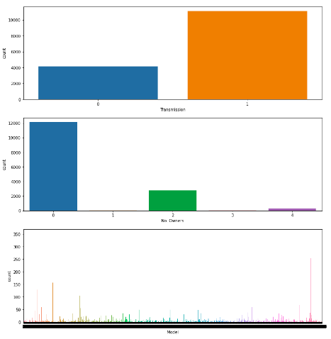
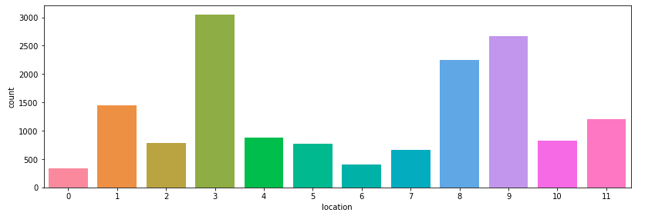
EDA
From the following graphs it is seen that feature Transmission has binary imbalance in class distribution. Columns No. Owners, Locations have uneven distribution between the classes. There are a few features where the classes have frequency lower than 10 which can make these values an outlier and decrease the model’s learning accuracy. Column Model have various unique values. Due, to the presence of such large number of unique values, the model cannot find relation between the features. This can be seen in the heat map analysis of the dataset.

Slide 11
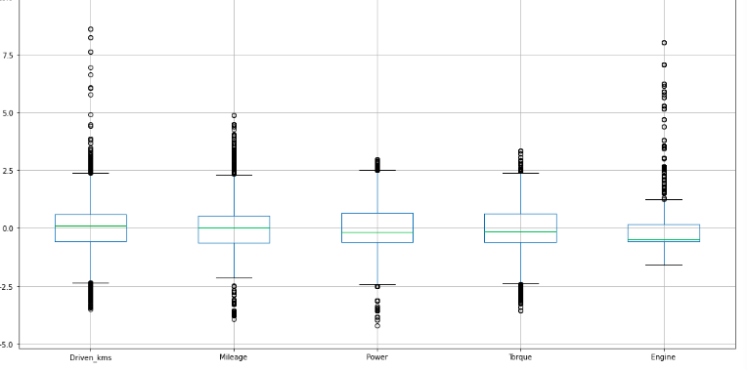
EDA
Outliers
Outliers
Outliers
The proportion of outliers that are eliminated using z-score method is higher than the allowed range of 7-8%. Therefore, IQR range is used to eliminate the outliers. as we can see the features have a few outliers. Column Engine has the highest number of outliers. We ignore the outliers in this column since it has a high correlation with the target feature and these outliers may help the model to understand outlier values better. The combined outliers in columns- Driven_kms, Mileage, Power, Torque are in the allowed range. These outliers are removed from the dataset..

Slide 12
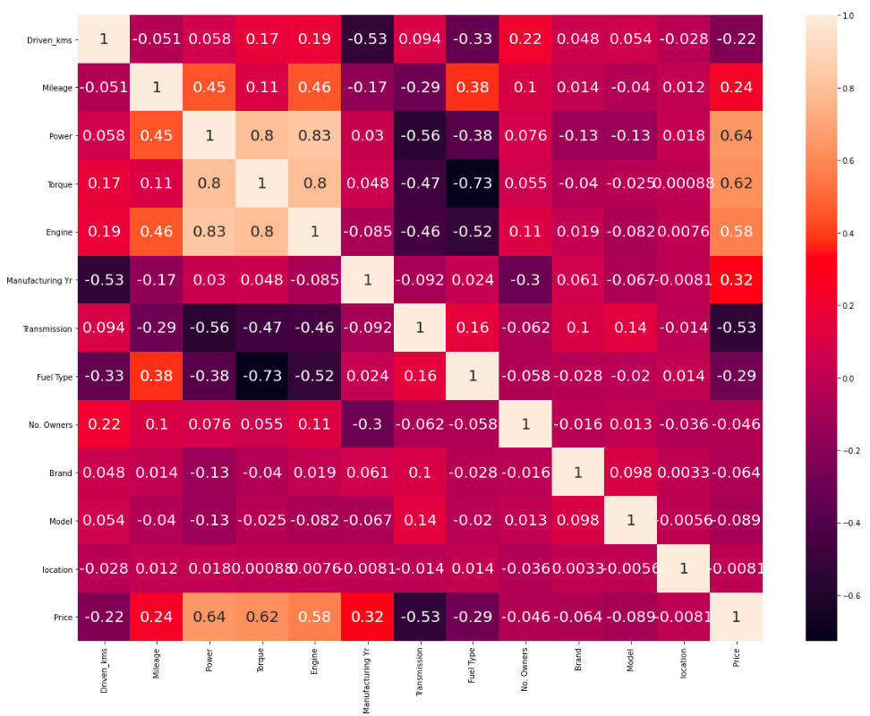
EDA
Heat Map
From the following heat map it is seen that columns Engine, Power and Torque have high correlation between them. This will cause multicolinearity between these features. In general, multicollinearity can lead to wider confidence intervals that produce less reliable probabilities in terms of the effect of independent variables in a model. Along with that models Power, Torque, Engine, Manufacturing Yr, Transmission, Fuel Type, Driven_kms, No. Owners have high correlation with target feature. Other columns can be ignored if required but it is better to keep them as they too have correlations with target feature.

Slide 13
Data Preprocessing.
Columns Power and Torque are merged together since power of a car is directly proportional to the torque of a car.
This will remove the multicolinearity between these two columns. Columns Power and Torque are dropped and a new column Pow_Tor is created by merging the columns.
Using the VIF values it can be seen that the multicolinearity is reduced.
The target feature is normalized using numpy library’s .log() function.
The dataset is split into training and testing set where the ratio between these values are 4:1 respectively.
The best random_state for the model is found to get the best degree of fit score or r2 score. This in return will give the lowest RMSE score.

Slide 14
Modeling
Multiple Regression models are used to make predictions. There are a few metrics that explains how well a model is able to perform and how accurate the predictions are. R-squared score is used to find the degree of fit of a dataset on a model. And RMSE or Root Mean Squared Error is the standard deviation of the residuals (prediction errors).Residuals are a measure of how far from the regression line data points are; RMSE is a measure of how spread out these residuals are. Models used in this project are:
Linear Models: Linear Regressor, Lasso Regressor, Ridge Regressor.
Decision Tree Regressor
K-Nearest Neighbor Regressor
Ensemble Technique
  Bagging : Using Random Forest Regressor
  Boosting : Using AdaBoost Regressor, XGBoost Regressor and Gradient Boosting Regressor.

Slide 15
Model Selection
After finding the performance of a regression model using R-squared score for all the models. It is seen the model XGBoost Regressor has the highest R-squared score among all of the models. Also the RMSE value for this model is the lowest.
XGBRegressor is selected for Hyperparameter Tuning.
The model XGBRegressor uses multiple paramters to make predictions. These parameters are set to a default value. Many combination of these parameters can be used to find the model with the best accuracy.
Parameters selected for tuning are “max_depth”, “learning_rate”,”n_estimators”,”gamma”,”num_parallel_tree”.
Different combinations of these models are used to find the model with the best R-squared score. This model is selected as the final model.

Slide 16
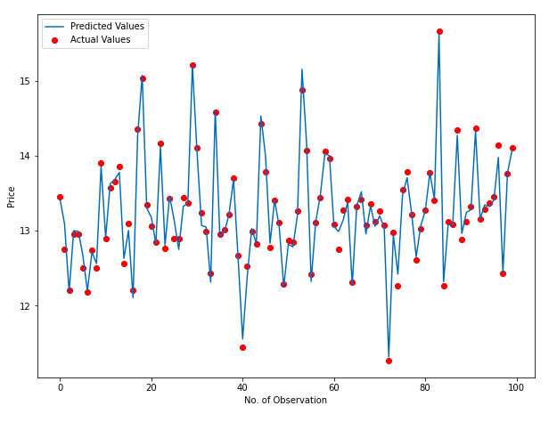
Final Model Evaluation
Implementing the final model on the dataset with scaled target value we get an R-squared score of 0.9796 and an RMSE score of 0.107. The mean cross validation score for this model is 0.975 with a standard deviation of 0.00164.
From the following graph the performance of model for 100 random entries can be seen.
From the graph it can be said that the model is able to predict the Prices with low RMSE scores.
The points in red are the actual values and the line plot gives the regrssion line. We see that the distance between the predicted values and actual values are very low. Therefore, we can say that this model is able to make predictions with good accuracy.

Slide 17
Final Model Evaluation
On scaling the predicted values and testing values back to the original values and on finding the Mean Absolute Error (MAE) for these values we get a score of 49,026.032. This is an important metric as it is a measure of average error values.
The lower MAE value that we get, the lower the error values will be. This means the model is predicting with higher accuracy.
The RMSE value for this model is very high when compared with scaled RMSE scores. However, this is due to the scaling of values and the mean error made by the models with unscaled and scaled values remain the same.
When measured for unscaled values we get a R-squared score of 0.9847 which is the highest for any model.

Slide 18
Conclusions
The highest performance score I was able to achieve on a model for this dataset is 0.9846.
This model has a RMSE score of 1,15,447.57. Which is relatively lower than other models.
Since, the value ranges quite a lot the model is able to predict prices of used cars which do not lie on the extreme ends of the Price range in the dataset.
There are some drawbacks to this model. For example, although the MAE score is relatively low. A model with even lower MAE score will be able to predict with less error.
More research on feature selection, data cleaning and pre-processing is needed.
This project can help the used car listing platforms and marketplace to make predictions based on the cars specifications and provide a better estimate to sellers and buyers alike.

